Slide 1




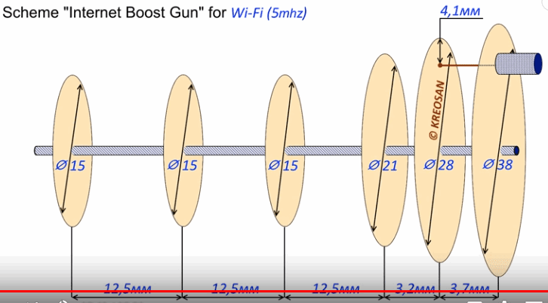
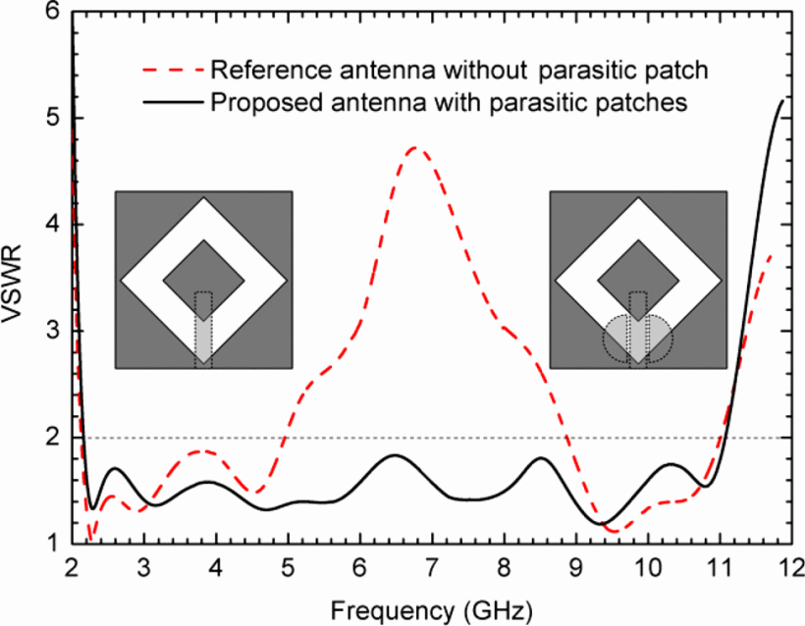
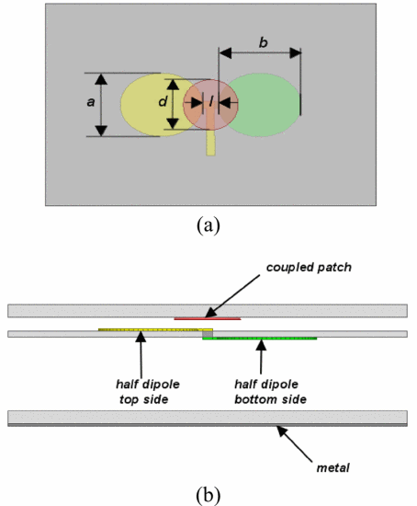
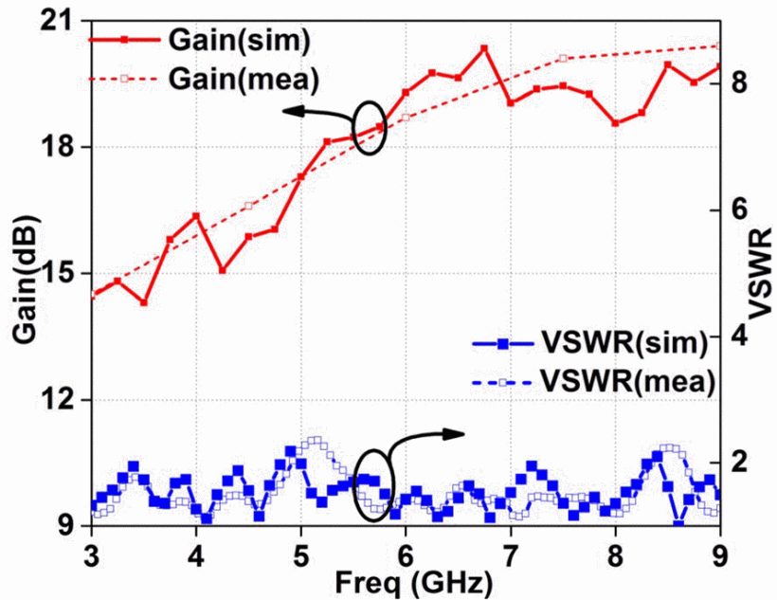




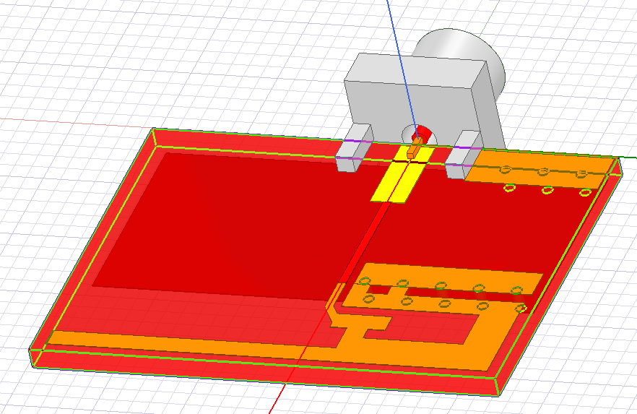
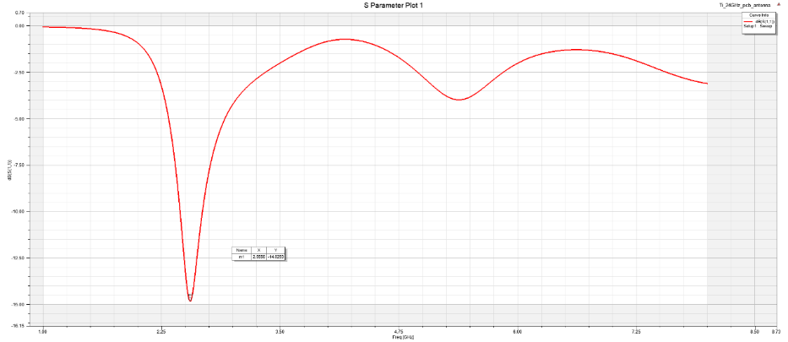
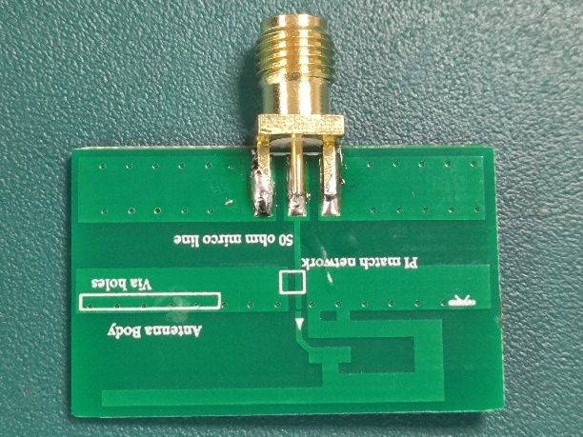
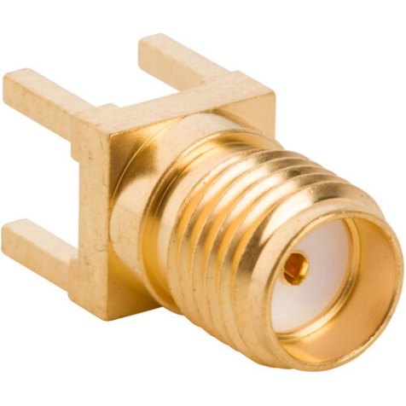
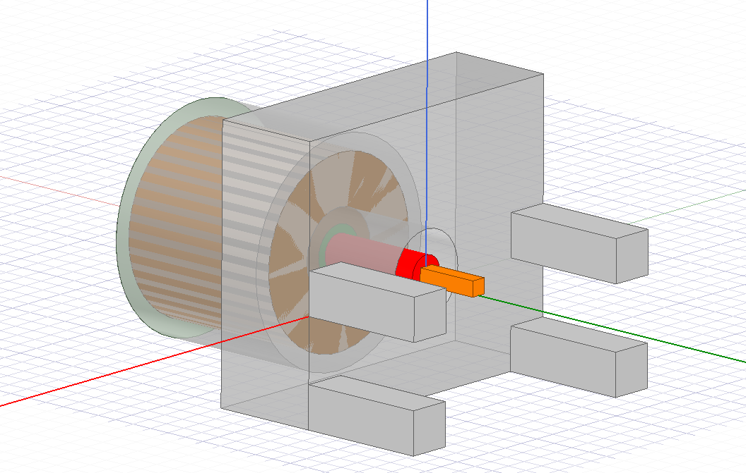
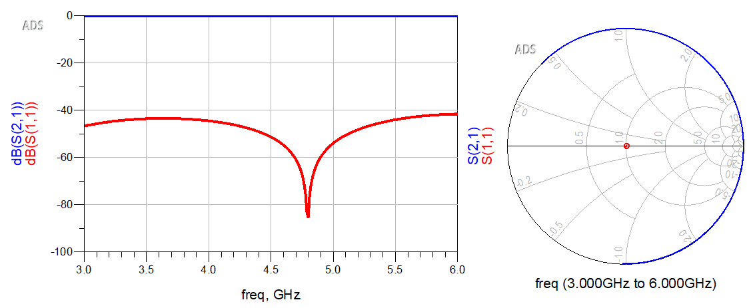
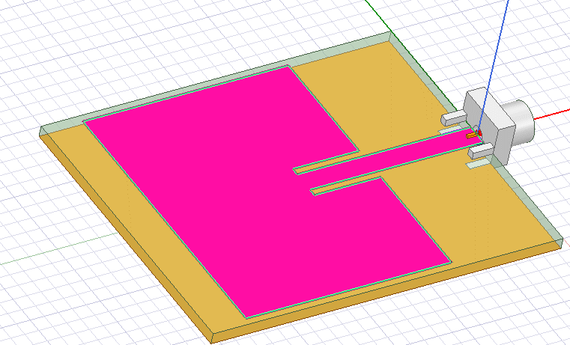
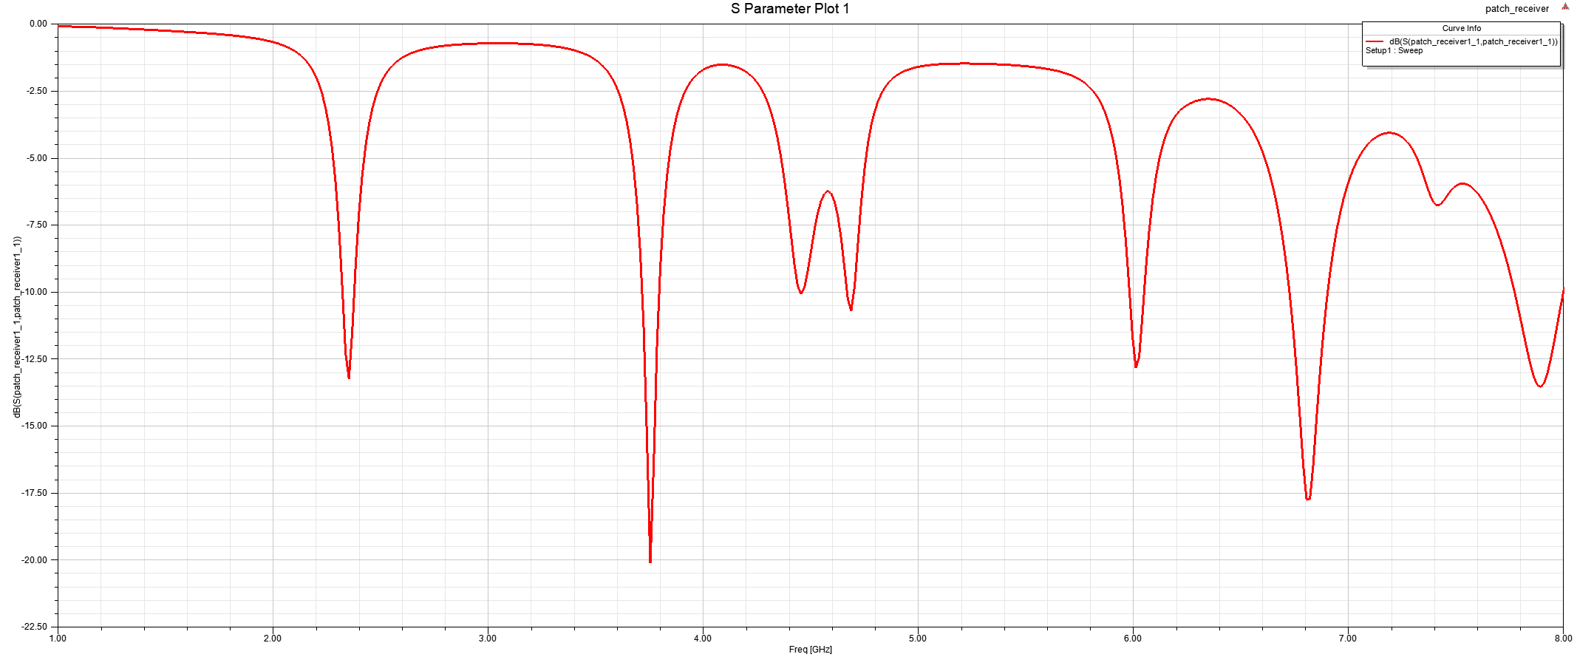
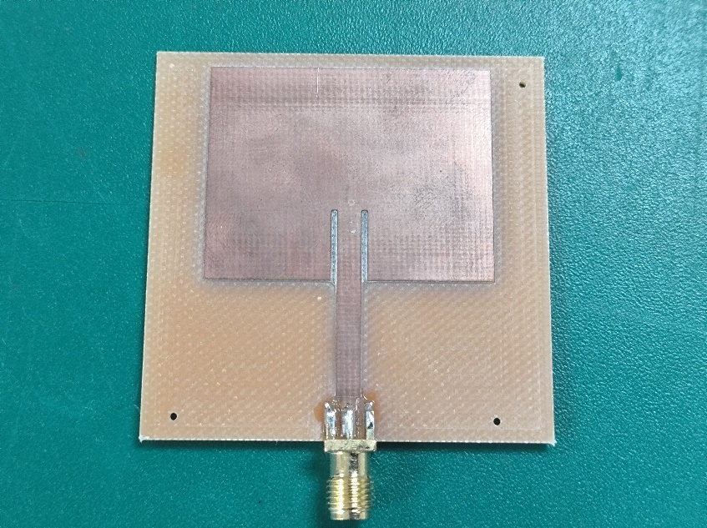
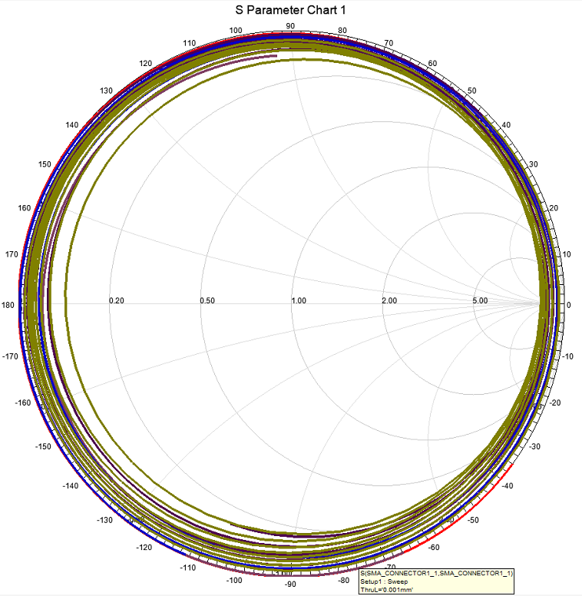
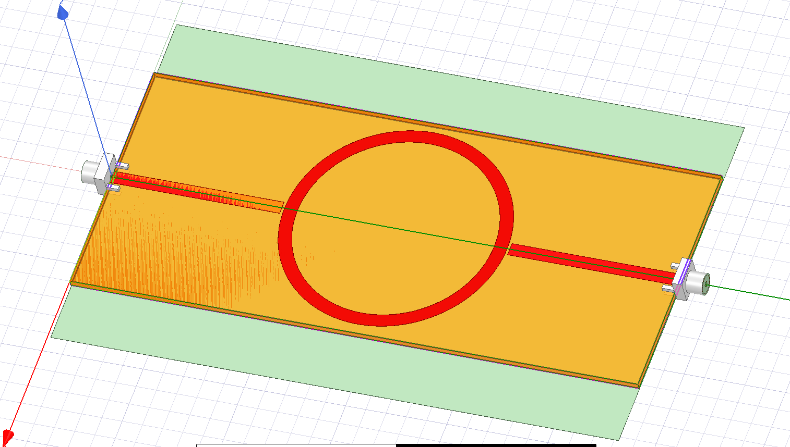
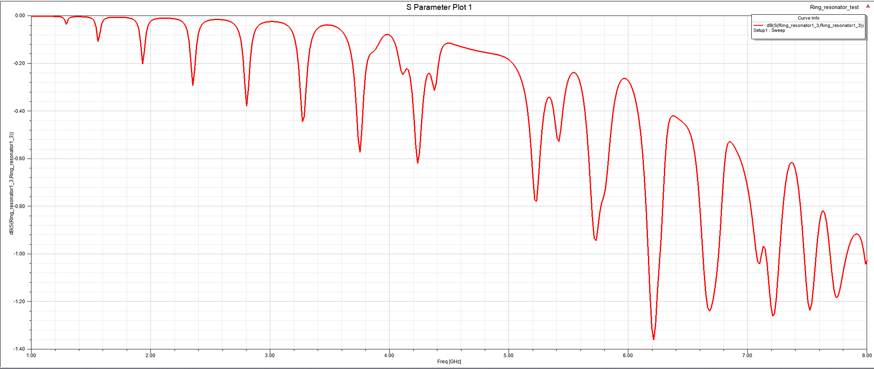
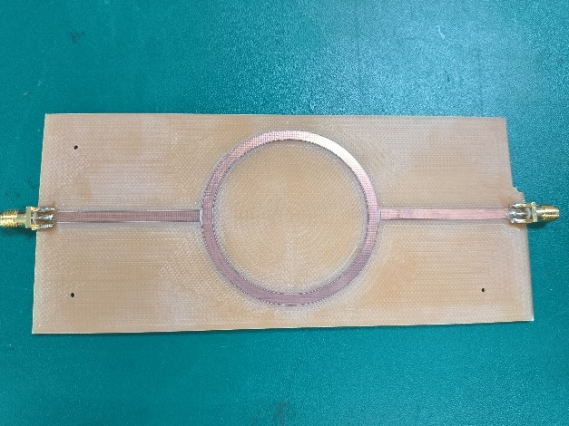
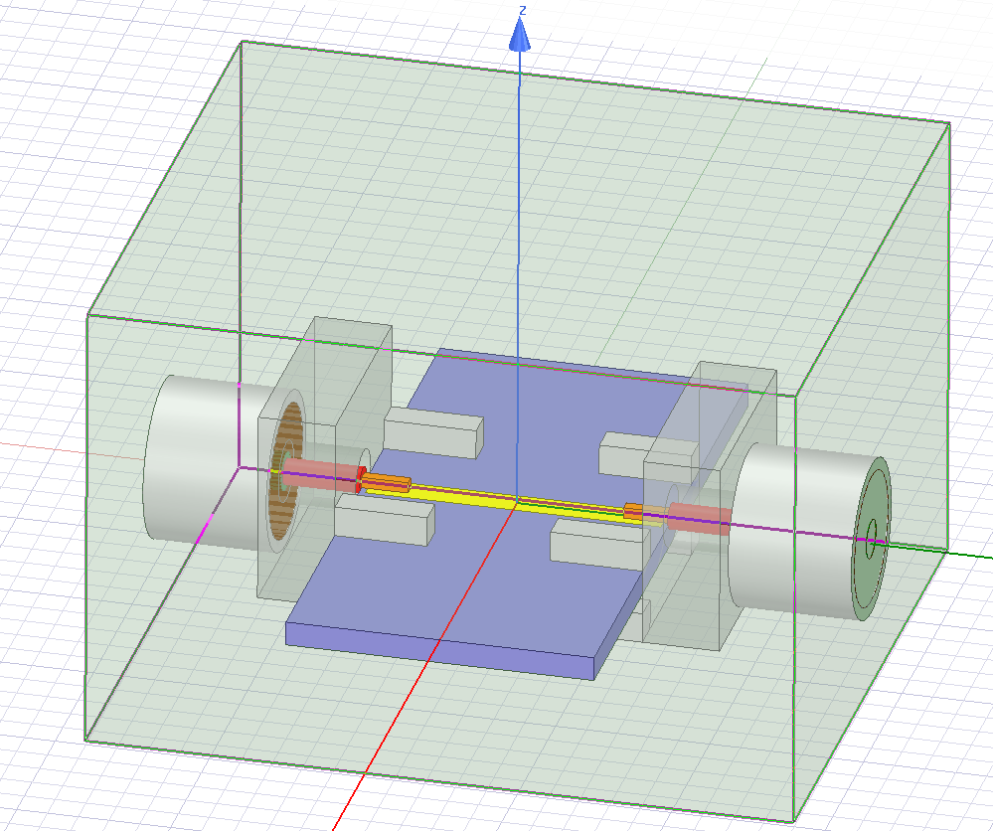
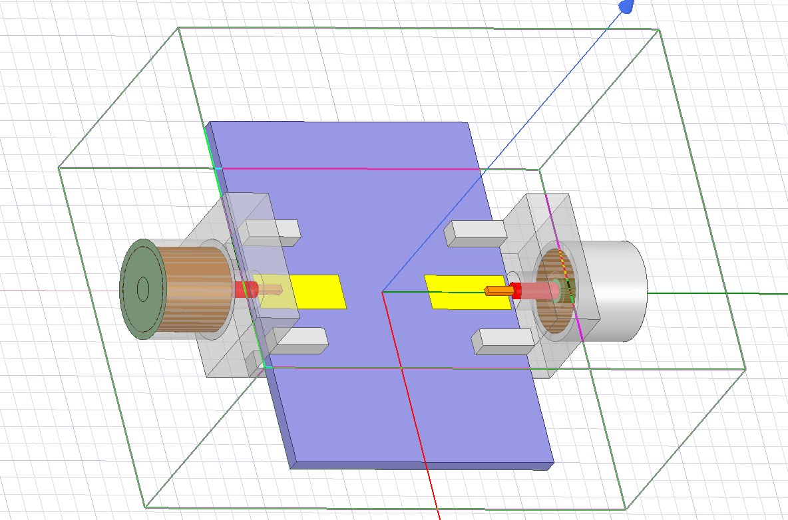
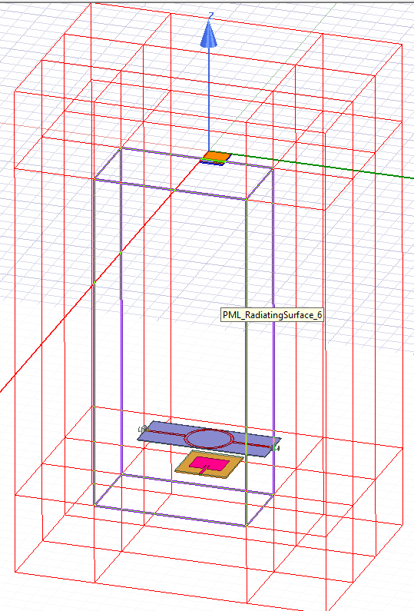
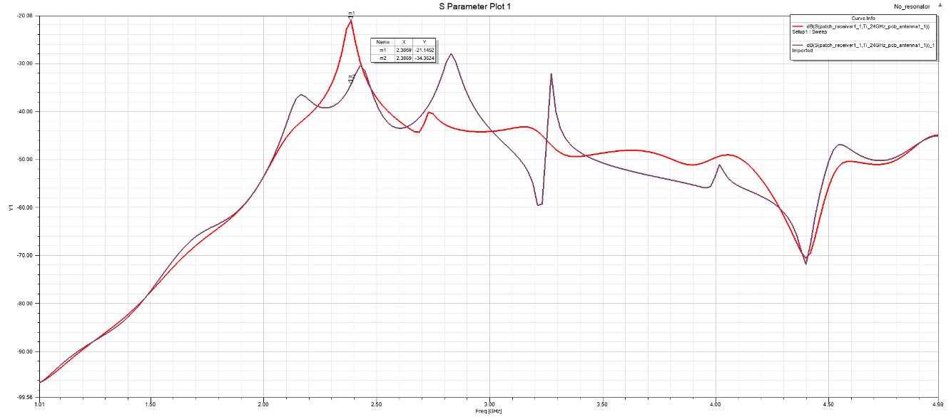
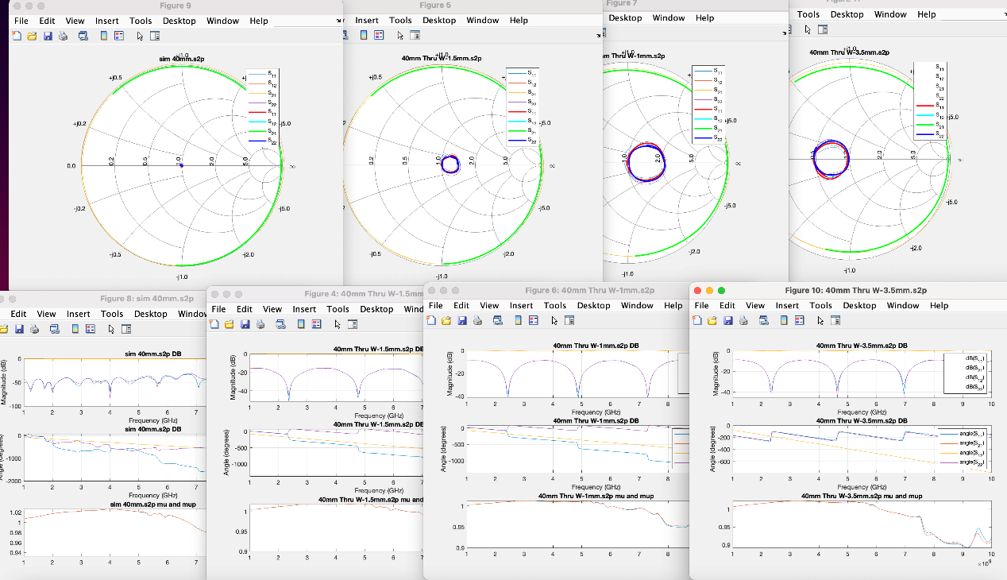
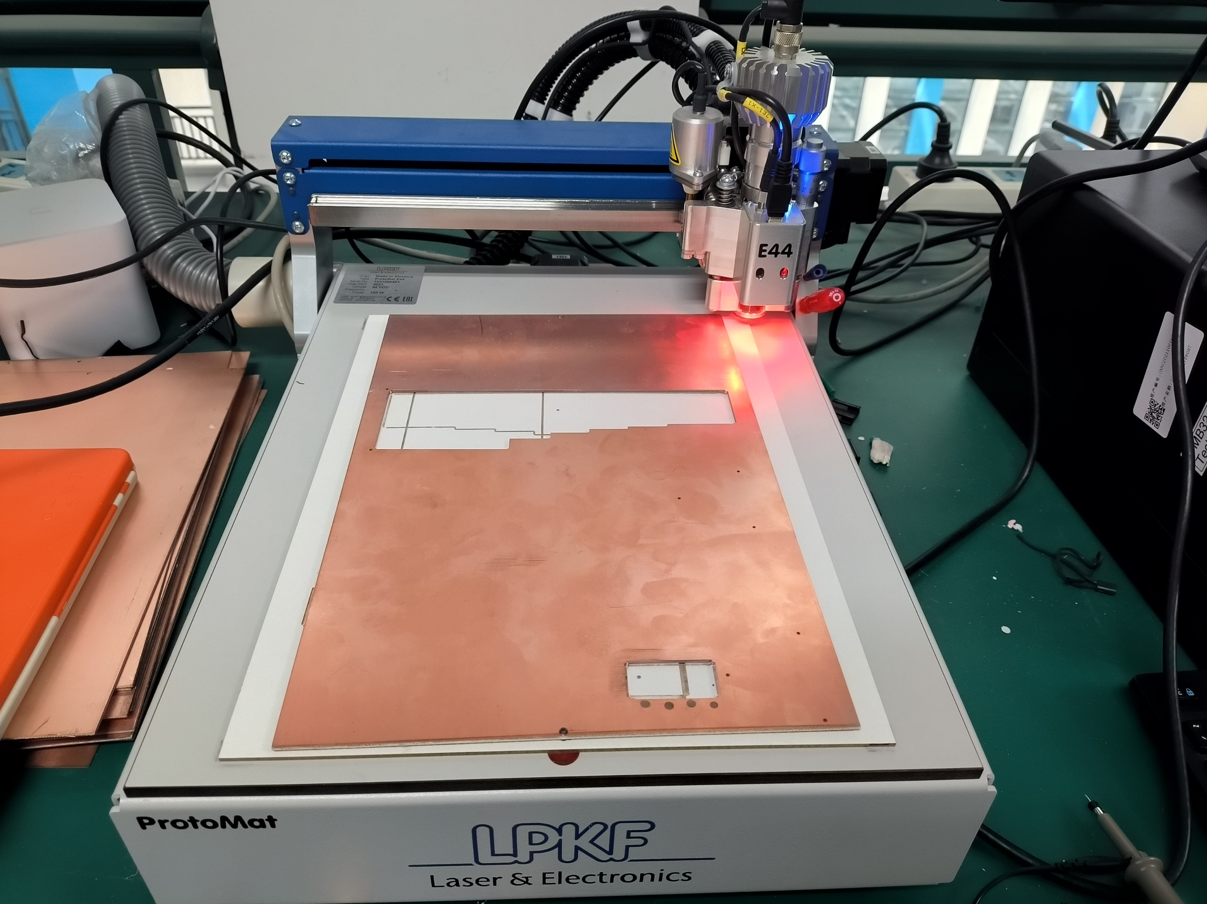
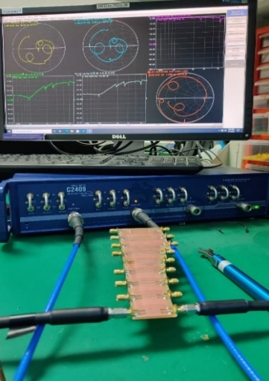
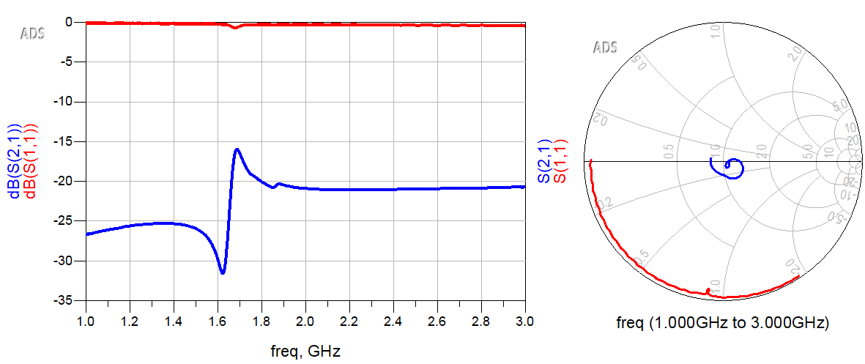
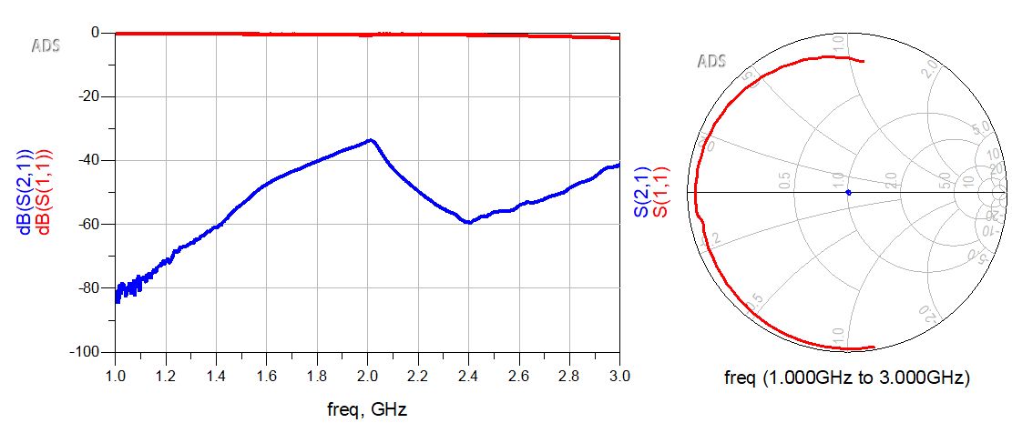
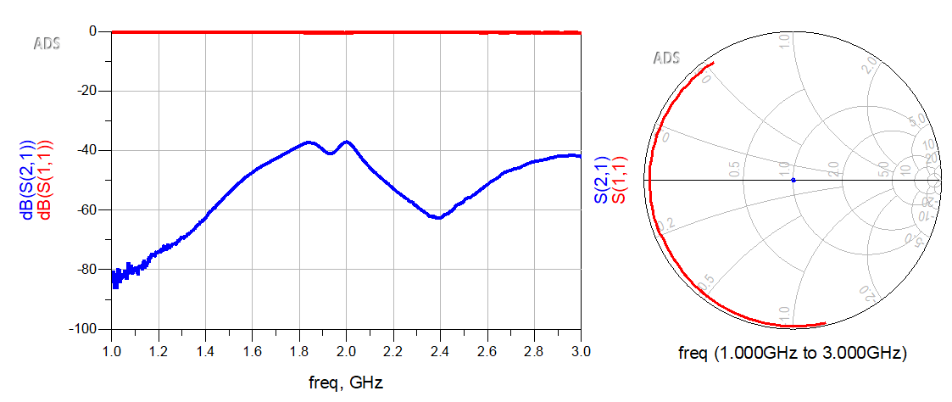
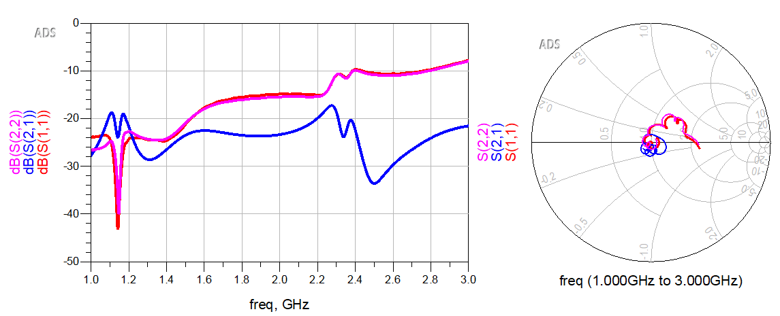
Broadband Antenna for WIFI Signal Enhancement
Supervisor: Dr. Shun Bai Moderator: Dr.Chiew-Foong Kwong
WIFI vs Cellular network
Traditional WIFI booster
Previous research methods
1.Transmitter: WIFI extender
1.Gain Enhancement
2.Receiver: WIFI Gun
Active
2.Bandwidth Enhancement
Large
1.Constructed on a printed circuit board using lump antenna components rather than large antenna components
2.Sacrifice area, directivity in order to enhance the signal in a specific direction, while simultaneously decreasing the signal intensity in the remaining angle of direction
Ideal Model
Characteristic
-Small
-Portable
-Passive
Maxwell Equations
Characteristic Impedance
Line Impedance
Impedance matching
Software
Hardware
Prerequisite Knowledges
Wave Equation
VSWR
Reflection Coefficient
Smith chart
Propagation Constant
Return loss
S-parameters
TRL calibration
 | HFSS Model | Frequency Performance | Fabricated Product
Monopole Antenna
Introduced test fixtures:
SMA connector
Patch Antenna
ADS simulation
Ring Resonator
Create HFSS Model
MATLAB & Fabrication
HFSS Test Model
Around 2.4GHz, the frequency performance indicated that the passive antenna resonator absorbed approximately 13.2dB.
VNA test & analysis
VNA test & analysis
There was around 9.1dB enhancement by the effect of this passive antenna resonator. However, comparing to the HFSS simulation, the average S21 was quite small, which already reaching around -40dB.

